Slide 1
Exploratory Data Analysis Project Report on Chocolate Bar Ratings
Group Members
Elliot Kojo Attipoe
Isaac Armah-Mensah
Franklin Kome Amoo

Slide 2
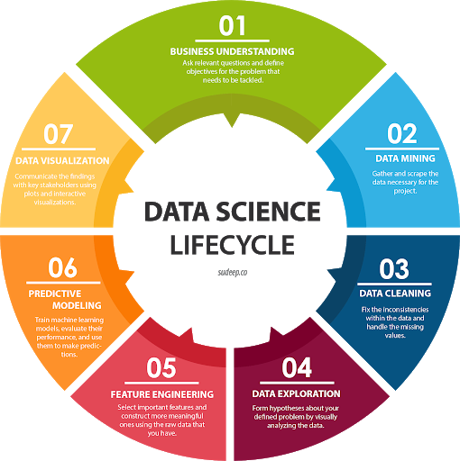
Introduction
Exploratory Data Analysis is part of the data science lifecycle

Slide 3
Definition of EDA
Exploratory Data Analysis (EDA) generally refers to the process of performing initial investigations on data with the aim of discovering patterns, anomalies, testing hypothesis or checking assumptions with the aid of descriptive statistics and graphical representations.

Slide 4
Steps involved in EDA
Step 1: Understanding the dataset
Step 2: Cleaning the dataset
Step 3:
Analysis of relationship

Slide 5
Source of dataset
The dataset used for this project is the Chocolate Bar Ratings which is compiled by Brady Brelinski, Founding Member of the Manhattan Chocolate Society.
Column | Description
Company (Maker-if known) | Name of the company manufacturing the bar.
Specific Bean Originor Bar Name | The specific geo-region of origin for the bar.
REF | A value linked to when the review was entered in the database. Higher = more recent.
ReviewDate | Date of publication of the review.
CocoaPercent | Cocoa percentage (darkness) of the chocolate bar being reviewed.
CompanyLocation | Manufacturer base country.
Rating | Expert rating for the bar.
BeanType | The variety (breed) of bean used, if provided.
Broad BeanOrigin | The broad geo-region of origin for the bean.

Slide 6
Hypothesis
Over time, there has been a correlation between cocoa ratings and the proportion of cocoa in a chocolate bar, as the quality of cocoa beans and chocolate bars has improved.

Slide 7
Hypothetical Questions.
Which countries produces the best cocoa beans?
Which countries have the highest-rated chocolate bars?
Is there relationship between the proportion of cocoa in chocolate bar and the rating?
What are the top ten companies with the highest rating?
What is the pattern over the years with respect to rating?
Is there a correlation between a bean’s origin and the average rating of bars?
Which chocolate beans have the highest ratings?

Slide 8
Results

